Slide 1
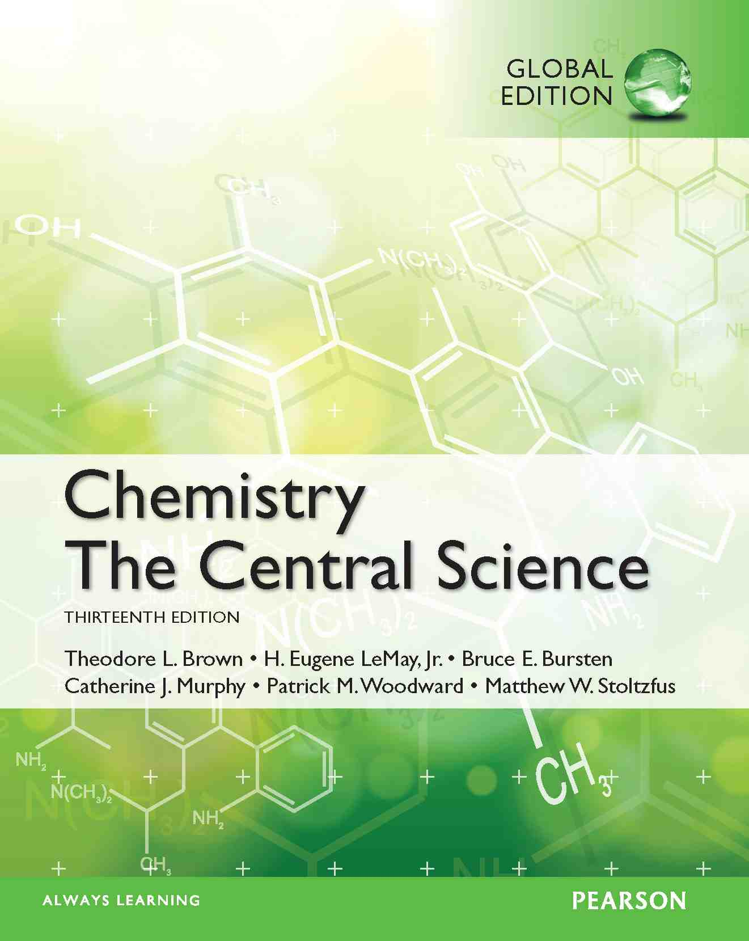
Lecture Presentation
Chapter 4
Reactions in Aqueous Solution
James F. Kirby
Quinnipiac University
Hamden, CT

Slide 2
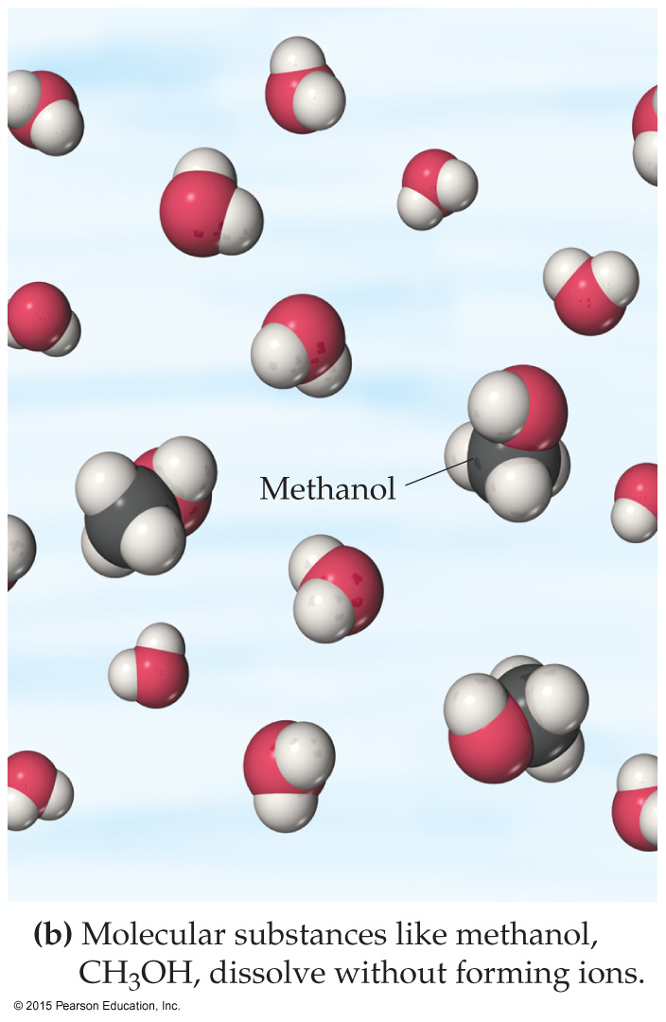
Solutions
Solutions are defined as homogeneous mixtures of two or more pure substances.
The solvent is present in greatest abundance.
All other substances are solutes.
When water is the solvent, the solution is called an aqueous solution.

Slide 3
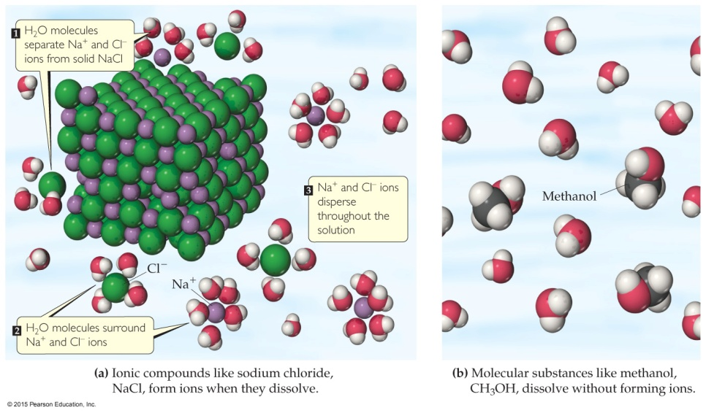
Aqueous Solutions
Substances can dissolve in water by different ways:
Ionic Compounds dissolve by dissociation, where water surrounds the separated ions.
Molecular compounds interact with water, but most do NOT dissociate.
Some molecular substances react with water when they dissolve.

Slide 4
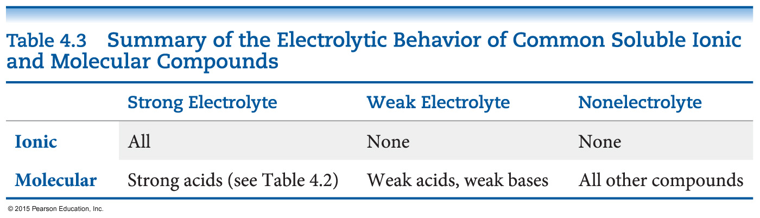
Electrolytes and Nonelectrolytes
An electrolyte is a substance that dissociates into ions when dissolved in water.
A nonelectrolyte may dissolve in water, but it does not dissociate into ions when it does so.

Slide 5
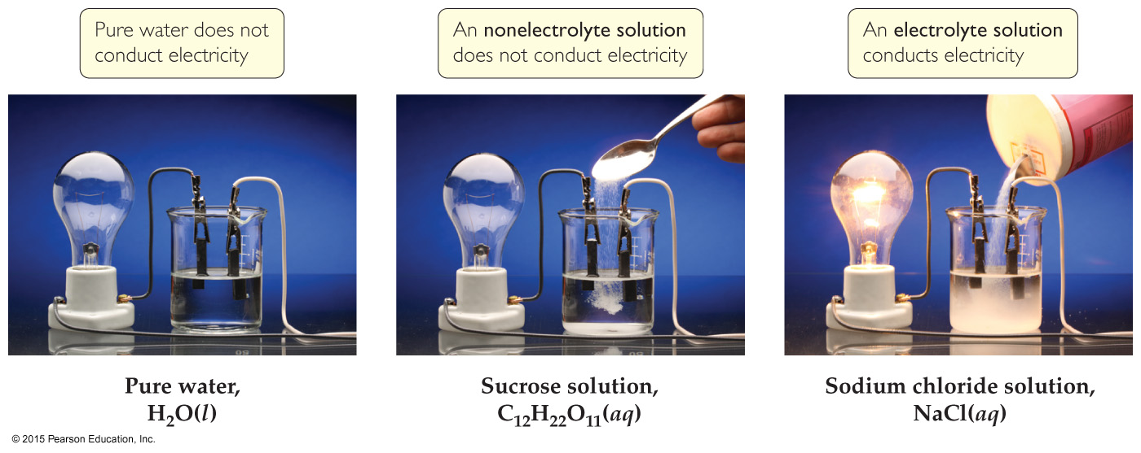
Electrolytes
A strong electrolyte dissociates completely when dissolved in water.
A weak electrolyte only dissociates partially when dissolved in water.
A nonelectrolyte does NOT dissociate in water.

Slide 6
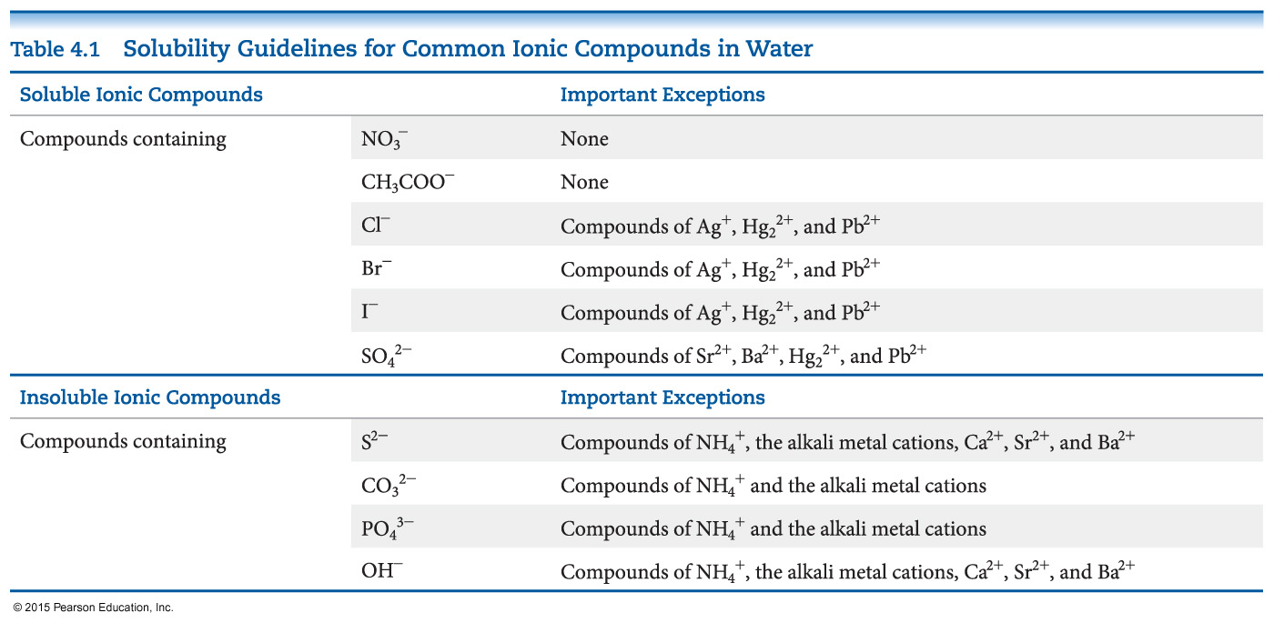
Solubility of Ionic Compounds
Not all ionic compounds dissolve in water.
A list of solubility rules is used to decide what combination of ions will dissolve.

Slide 7
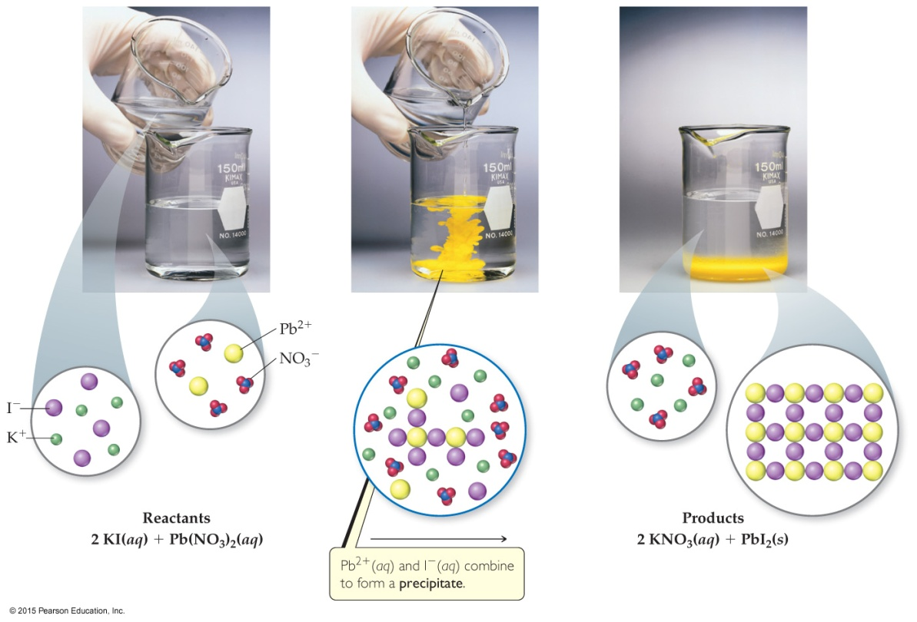
Precipitation Reactions
When two solutions containing soluble salts are mixed, sometimes an insoluble salt will be produced. A salt “falls” out of solution, like snow out of the sky. This solid is called a precipitate.

Slide 8
Metathesis (Exchange) Reactions
Metathesis comes from a Greek word that means “to transpose.”
It appears as though the ions in the reactant compounds exchange, or transpose, ions, as seen in the equation below.
AgNO₃(aq) + KCl(aq) ⎯→ AgCl(s) + KNO₃(aq)

Slide 9
Completing and Balancing Metathesis Equations
Steps to follow
Use the chemical formulas of the reactants to determine which ions are present.
Write formulas for the products: cation from one reactant, anion from the other. Use charges to write proper subscripts.
Check your solubility rules. If either product is insoluble, a precipitate forms.
Balance the equation.

Slide 10
Ways to Write Metathesis Reactions
Molecular equation
Complete ionic equation
Net ionic equation

Slide 11
Molecular Equation
The molecular equation lists the reactants and products without indicating the ionic nature of the compounds.
AgNO₃(aq) + KCl(aq) ⎯→ AgCl(s) + KNO₃(aq)

Slide 12
Complete Ionic Equation
In the complete ionic equation all strong electrolytes (strong acids, strong bases, and soluble ionic salts) are dissociated into their ions.
This more accurately reflects the species that are found in the reaction mixture.
Ag⁺(aq) + NO₃⁻(aq) + K⁺(aq) + Cl⁻(aq) ⎯→
AgCl(s) + K⁺(aq) + NO₃⁻(aq)

Slide 13
Net Ionic Equation
To form the net ionic equation, cross out anything that does not change from the left side of the equation to the right.
The ions crossed out are called spectator ions, K+ and NO₃⁻, in this example.
The remaining ions are the reactants that form the product—an insoluble salt in a precipitation reaction, as in this example.
Ag⁺(aq) + NO₃⁻(aq) + K⁺(aq) + Cl⁻(aq) ⎯→
AgCl(s) + K⁺(aq) + NO₃⁻(aq)

Slide 14
Writing Net Ionic Equations
Write a balanced molecular equation.
Dissociate all strong electrolytes.
Cross out anything that remains unchanged from the left side to the right side of the equation.
Write the net ionic equation with the species that remain.

Slide 15
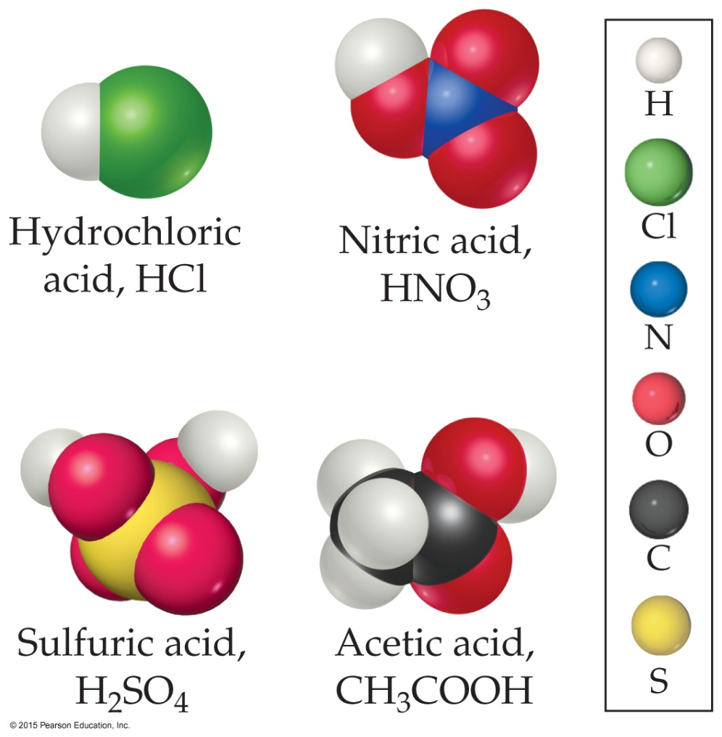
Acids
The Swedish physicist and chemist S. A. Arrhenius defined acids as substances that increase the concentration of H⁺ when dissolved in water.
Both the Danish chemist J. N. Brønsted and the British chemist T. M. Lowry defined them as proton donors.

Slide 16
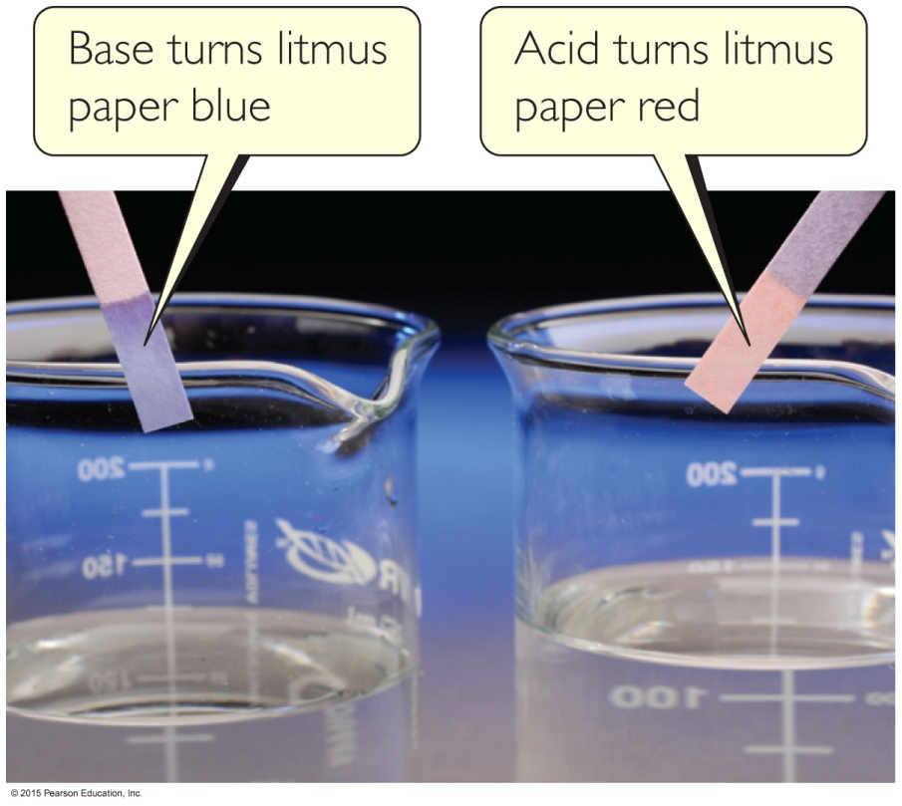
Bases
Arrhenius defined bases as substances that increase the concentration of OH⁻ when dissolved in water.
Brønsted and Lowry defined them as proton acceptors.

Slide 17
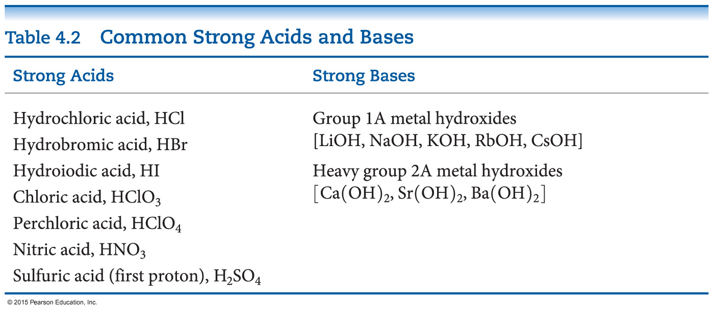
Strong or Weak?
Strong acids completely dissociate in water; weak acids only partially dissociate.
Strong bases dissociate to metal cations and hydroxide anions in water; weak bases only partially react to produce hydroxide anions.

Slide 18
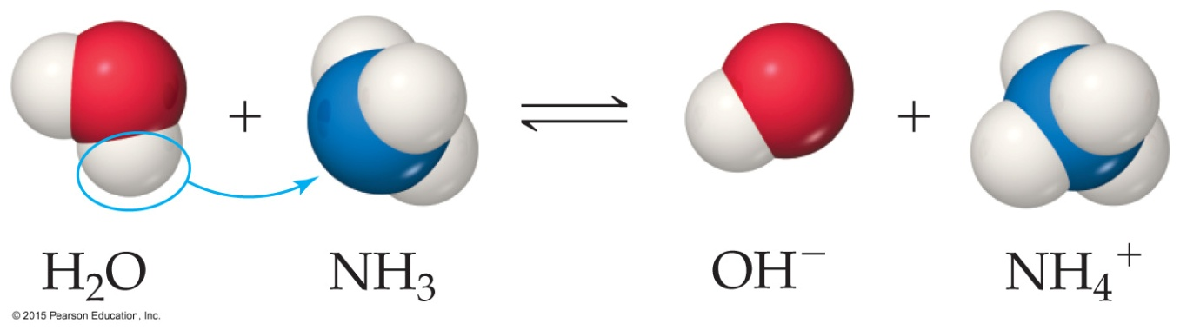
Acid-Base Reactions
In an acid–base reaction, the acid (H₂O above) donates a proton (H⁺) to the base (NH₃ above).
Reactions between an acid and a base are called neutralization reactions.
When the base is a metal hydroxide, water and a salt (an ionic compound) are produced.

Slide 19
Neutralization Reactions
When a strong acid (like HCl) reacts with a strong base (like NaOH), the net ionic equation is circled below:
HCl(aq) + NaOH(aq) ⎯→ NaCl(aq) + H₂O(l)
H⁺(aq) + Cl⁻(aq) + Na⁺(aq) + OH⁻(aq) ⎯→
Na⁺(aq) + Cl⁻(aq) + H₂O(l)
H⁺(aq) + OH⁻(aq) ⎯→ H₂O(l)

Slide 20
Gas-Forming Reactions
Some metathesis reactions do not give the product expected.
When a carbonate or bicarbonate reacts with an acid, the products are a salt, carbon dioxide, and water.
CaCO₃(s) + 2 HCl(aq) ⎯→CaCl₂(aq) + CO₂(g) + H₂O(l)
NaHCO₃(aq) + HBr(aq) ⎯→NaBr(aq) + CO₂(g) + H₂O(l)

Slide 21
Gas-Forming Reactions
This reaction gives the predicted product, but you had better carry it out in the hood—the gas produced has a foul odor!
Na₂S(aq) + H₂SO₄(aq) ⎯→ Na₂SO₄(aq) + H₂S(g)

Slide 22
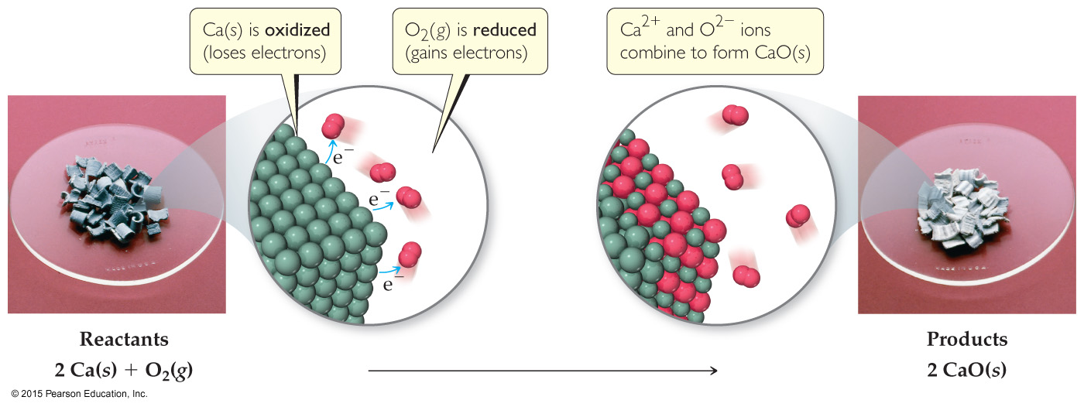
Oxidation-Reduction Reactions
Loss of electrons is oxidation.
Gain of electrons is reduction.
One cannot occur without the other.
The reactions are often called redox reactions.

Slide 23
Oxidation Numbers
To determine if an oxidation–reduction reaction has occurred, we assign an oxidation number to each element in a neutral compound or charged entity.

Slide 24
Rules to Assign Oxidation Numbers
Elements in their elemental form have an oxidation number of zero.
The oxidation number of a monatomic ion is the same as its charge.

Slide 25
Rules to Assign Oxidation Numbers
Nonmetals tend to have negative oxidation numbers, although some are positive in certain compounds or ions.
Oxygen has an oxidation number of −2, except in the peroxide ion, in which it has an oxidation number of −1.
Hydrogen is −1 when bonded to a metal, +1 when bonded to a nonmetal.

Slide 26
Rules to Assign Oxidation Numbers
Nonmetals tend to have negative oxidation numbers, although some are positive in certain compounds or ions.
Fluorine always has an oxidation number of −1.
The other halogens have an oxidation number of −1 when they are negative; they can have positive oxidation numbers, most notably in oxyanions.

Slide 27
Rules to Assign Oxidation Numbers
The sum of the oxidation numbers in a neutral compound is zero.
The sum of the oxidation numbers in a polyatomic ion is the charge on the ion.

Slide 28
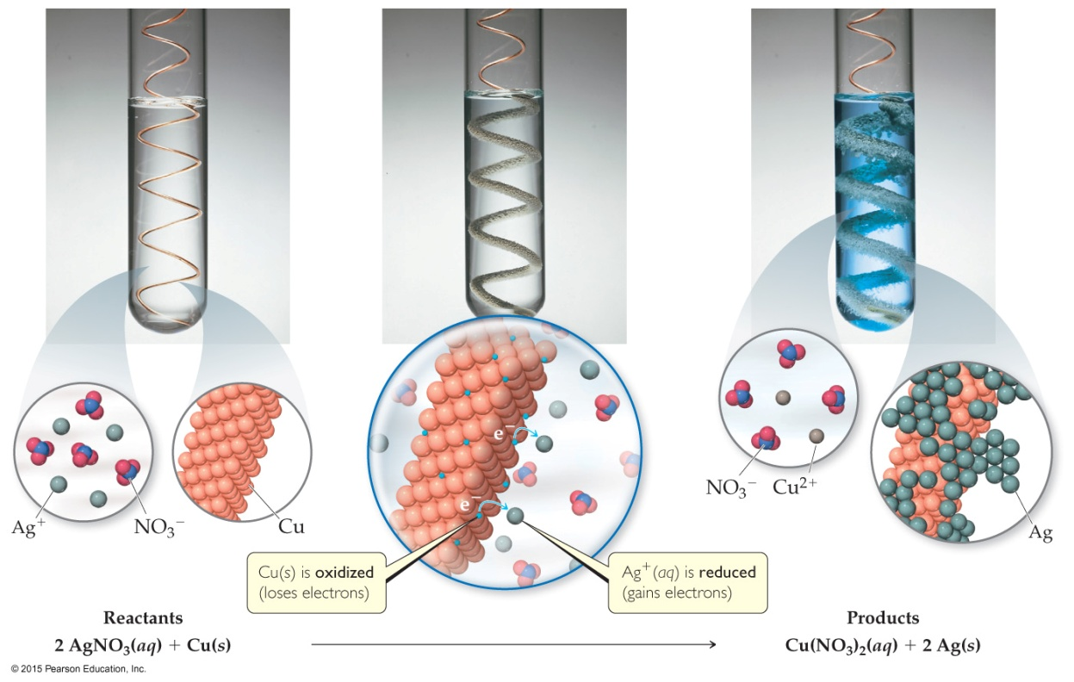
Displacement Reactions
In displacement reactions, ions oxidize an element.
In this reaction, silver ions oxidize copper metal:
Cu(s) + 2 Ag⁺(aq) ⎯→ Cu²⁺(aq) + 2 Ag(s)
The reverse reaction does NOT occur. Why not?

Slide 29
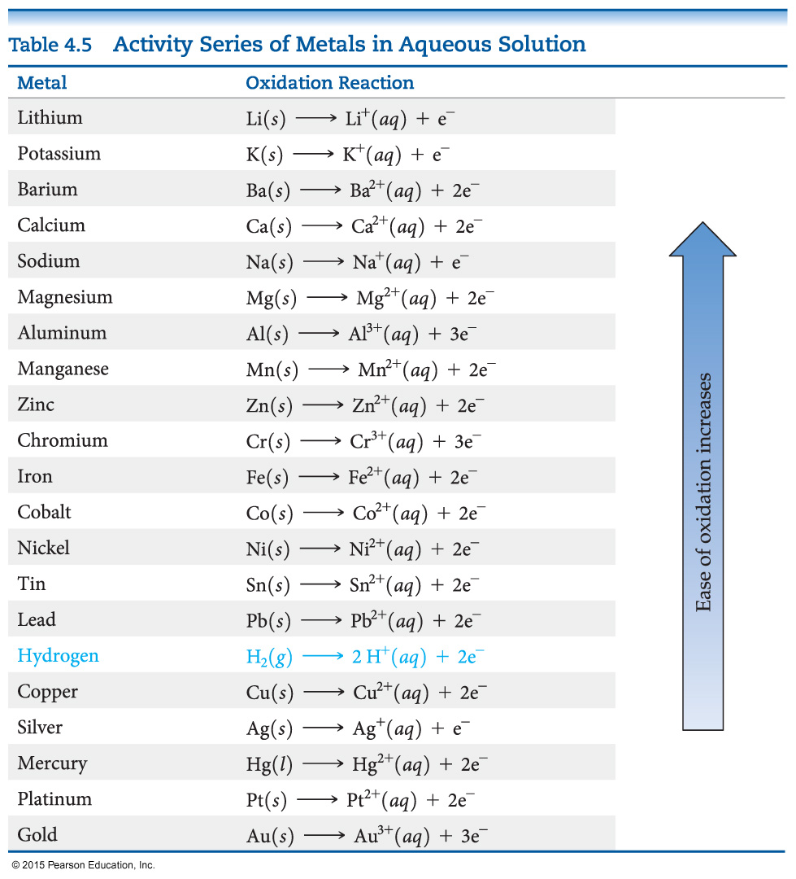
Activity Series
Elements higher on the activity series are more reactive.
They are more likely to exist as ions.

Slide 30
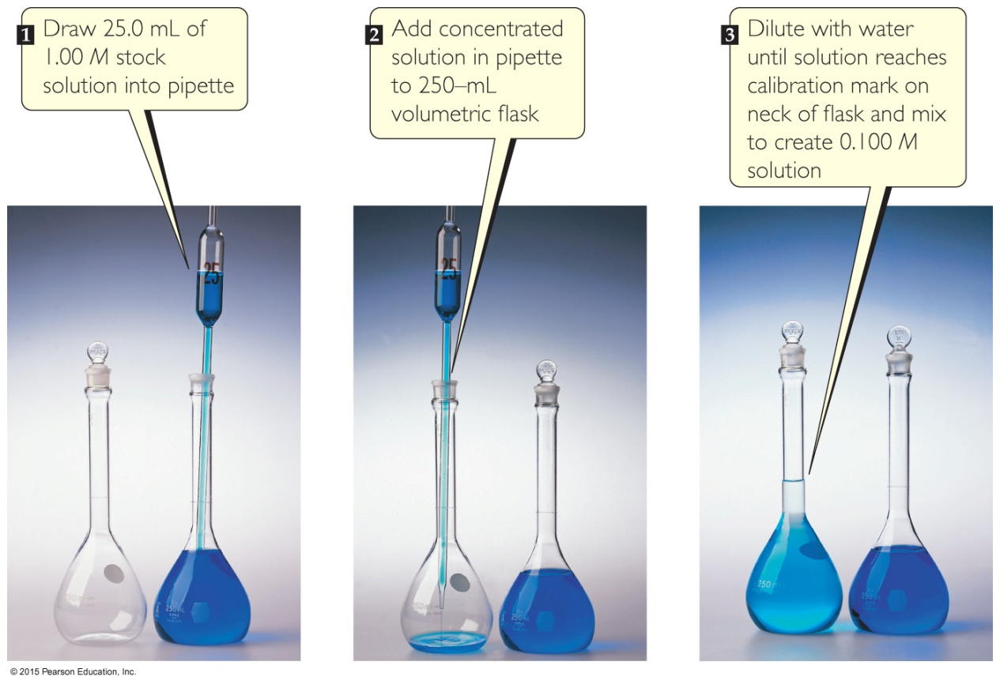
Metal/Acid Displacement Reactions
The elements above hydrogen will react with acids to produce hydrogen gas.
The metal is oxidized to a cation.

Slide 31
Molarity
The quantity of solute in a solution can matter to a chemist.
We call the amount dissolved its concentration.
Molarity is one way to measure the concentration of a solution:
moles of solute
Molarity (M) =
volume of solution in liters

Slide 32
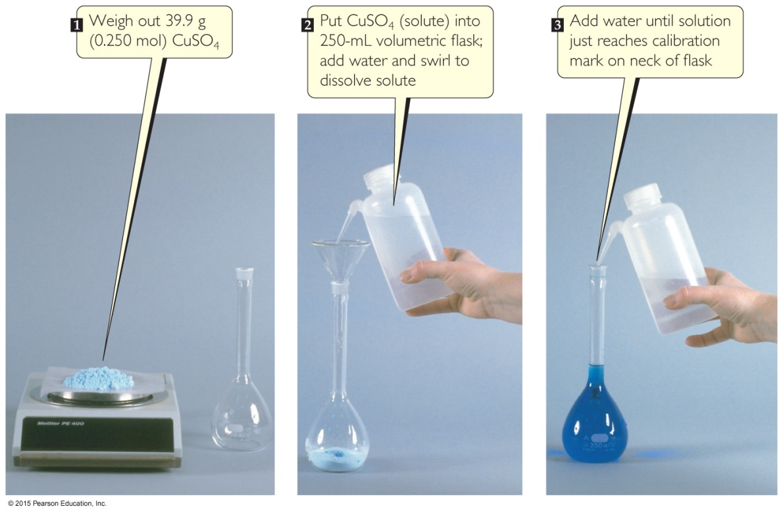
Mixing a Solution
To create a solution of a known molarity, weigh out a known mass (and, therefore, number of moles) of the solute.
Then add solute to a volumetric flask, and add solvent to the line on the neck of the flask.

Slide 33

Dilution
One can also dilute a more concentrated solution by
using a pipet to deliver a volume of the solution to a new volumetric flask, and
adding solvent to the line on the neck of the new flask.

Slide 34
Dilution
The molarity of the new solution can be determined from the equation
M_{c} × V_{c} = M_{d} × V_{d},
where M_{c} and M_{d} are the molarity of the concentrated and dilute solutions, respectively, and V_{c} and V_{d} are the volumes of the two solutions.

Slide 35
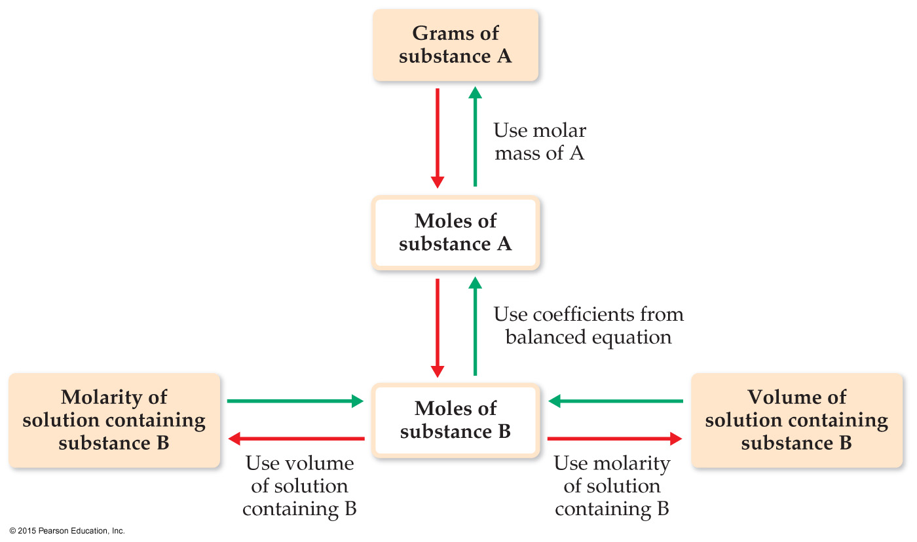
Using Molarities in Stoichiometric Calculations

Slide 36
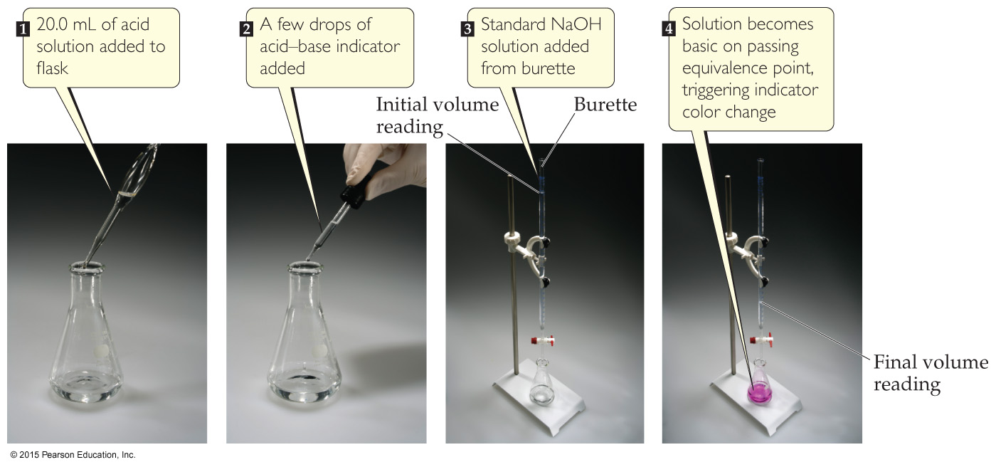
Titration
A titration is an analytical technique in which one can calculate the concentration of a solute in a solution.

Slide 37
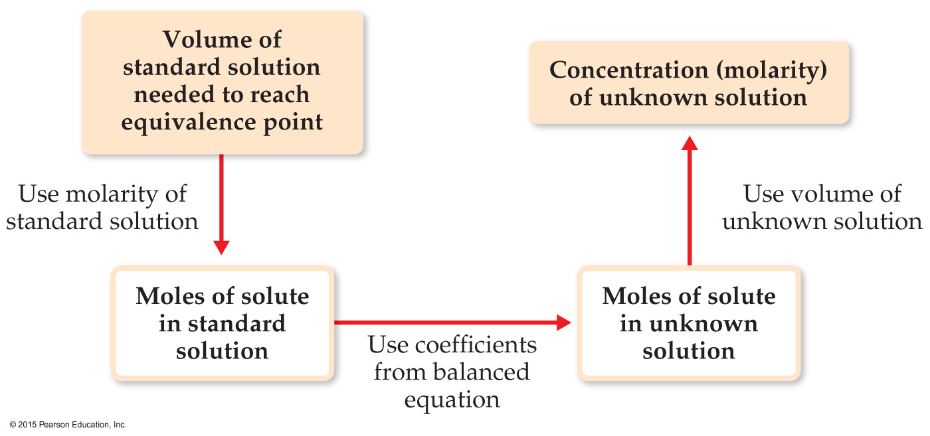
Titration
A solution of known concentration, called a standard solution, is used to determine the unknown concentration of another solution.
The reaction is complete at the equivalence point.

